Slide 1
Apple´s Friends
one step further Zippy´s Friends

Slide 2
Agenda
Why to implement an emotional health promotion programme?
Why Apple’s Friends was created?
Programme overview
Brazilian process of implementation
Evaluation results

Slide 3
Treatment

Slide 4
Prevention

Slide 5
Health Promotion

Slide 6
Treatment
Prevention
Health
Promotion

Slide 7
Why Apple’s Friends was created?
Zippy’s Friends was making a big impact on children´s emotional and social skills
Zippy’s Friends teachers were “Zipped”
developed their own emotional and social skills
were providing special environment for their children
The more the children were practicing their skills, the more they were improving
So, school principals and parents were looking for keeping the same environment at school in the following year

Slide 8
Objectives
To enlarge “Zippy’s Friends” (ZF) coping skills
(deal with more complex feelings and more complex situations)
To develop emotional and social skills in children that have not taken part in ZF
To expand ZF philosophy in school comunity

Slide 10
How it is organized
6 modules
Feelings
Communication
Friendship
Solving Problems
Changes
Moving forward
26 sessions – 45 to 60 minutes each

Slide 11
Each module has
3 sessions
Foccus in one specific theme
Flexibility in format
Open for children contribution
4th session
Mini story for children to discuss and decide how it ends

Slide 13
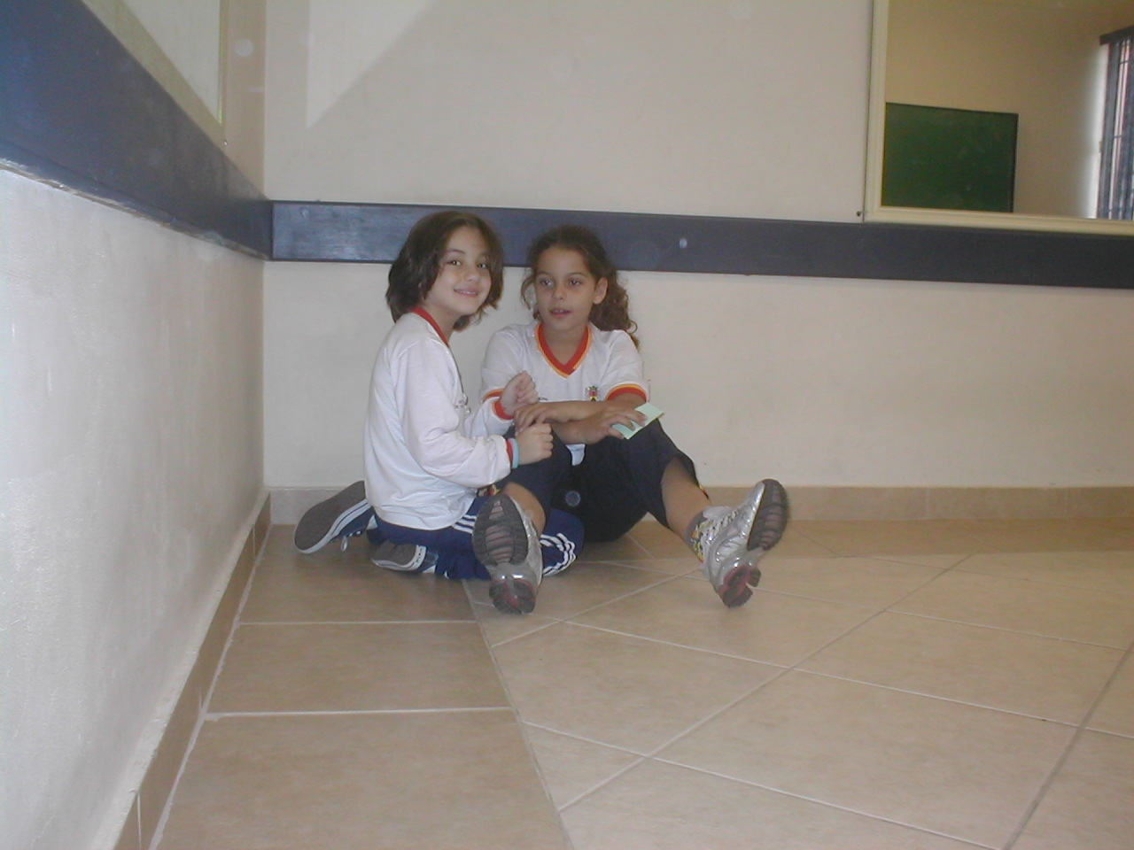

Slide 14
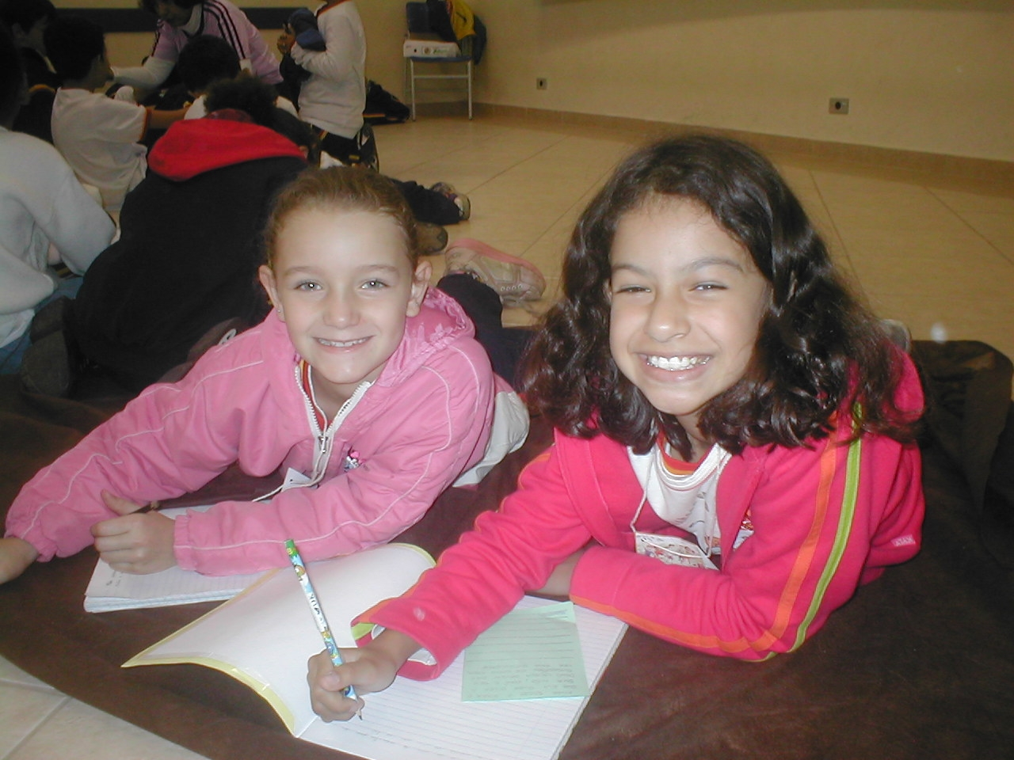

Slide 15
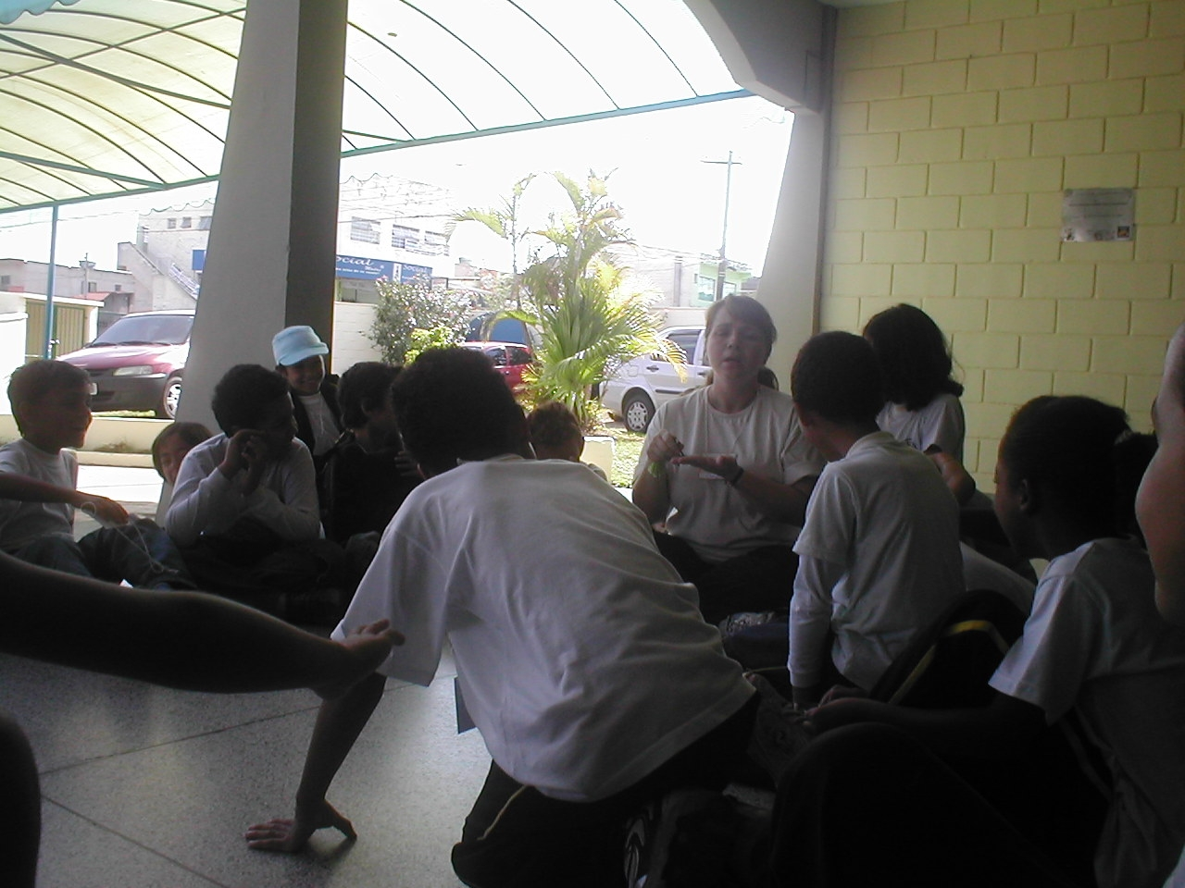

Slide 16
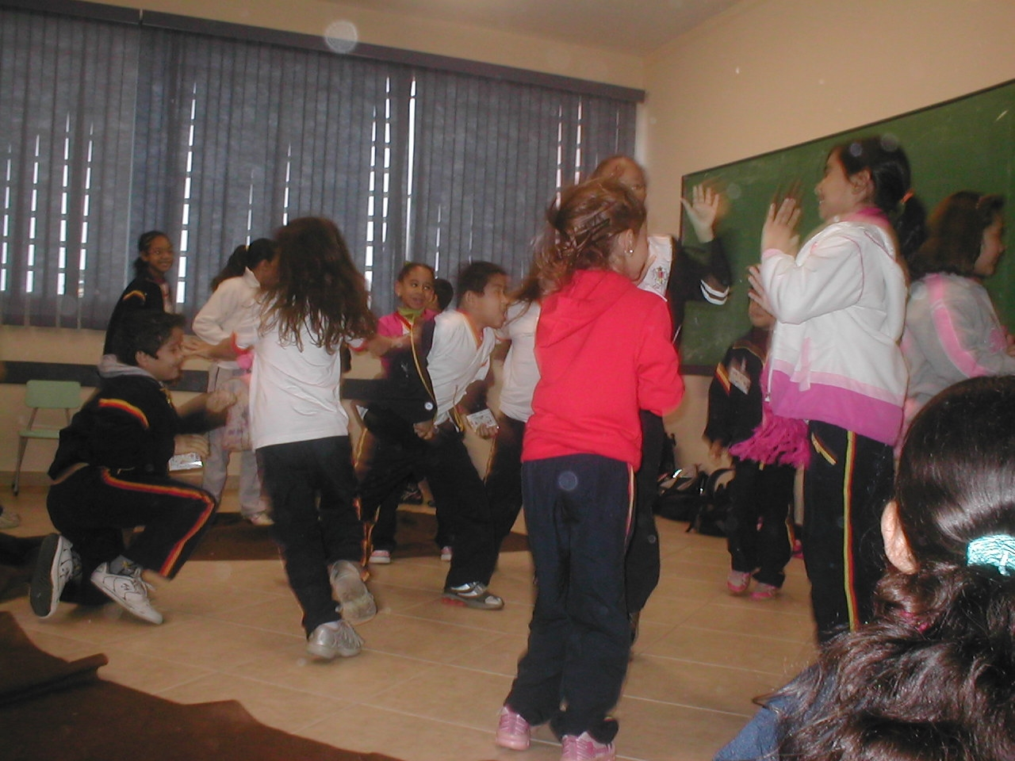

Slide 17
In Brazil
2008 – first pilot – 51 teachers and 1,718 children
2009 – second pilot – 88 teachers and 3,369 children
2010 – independent evaluation
– Netherlands pilot
2011 – Partnership for Children produced a
international version of AF
2012 – third Brazilian version – 10,802 children
Total – 444 teachers and 22,689 children

Slide 18
Evaluation
Dr. Thereza Penna Firme
… first of all we would highlight the amazing results, which are worthy of praise both with regard to the impact of the Apple’s Friends Programme on the children and on the teachers involved, and with regard to the merit of the way it is run.
More specifically, with regard to the 1st Impact Question, i.e. To what extent did the teacher teach the Programme in accordance with the training?, the results show that the teachers, when teaching the six modules of the Programme, showed success in the performance, in accordance with the conception and the guidelines of the Programme. Furthermore, they showed an improvement in their work, as it was being implemented.
With regard to the 2nd Impact Question, i.e., What is the evidence of the impact of the Apple’s Friends Programme on the social and coping skills of the children?, the results … revealed a marked improvement both in the children, irrespective of whether the teachers were zipped or non-zipped. With regard to the behaviours or coping strategies, in the view of the teachers and of the parents or guardians, …, there was a significant increase in positive and desirable strategies and also a significant reduction in negative and undesirable strategies.

Slide 19
Evaluation
With regard to the 3rd Impact Question, i.e. “What impacts did the training and teaching of the Apple’s Friends Programme have on the teacher, in his/her personal and professional life?”, the results point to an extraordinary influence both on the life of zipped teachers and non-zipped teachers.
…
Finally, with regard to the 2nd Merit Question, i.e., “To what extent do the children participate in and enjoy the activities developed in the Apple’s Friends Programme?”, the results of more than 2,000 children affected show their enthusiastic happiness about participating in the programme, attesting to the excellence of “Apple’s Friends”, in its conception, in its execution and in its transforming power.
So, it is mandatory to declare that Apple´s Friends proved its relevance and importance, reaching its high level purpose - the child.

Slide 20
From Teachers
“I was always afective with my students; I´m optimist and always tryed to build a positive auto steem in all children. But I recognize I was always very explosive. With Apple´s Friends I learnt auto control, pacience and I´m looking forward to match my speech with my practice. Honestly, I would like to keep runing it forever.”
“I´ve changed the way I look to my children; because, in order to run the activities, I had to try to let them free to express themselves and, then, I found how important is for them to be alowed to talk.”
“My “person” thanks for the opportunity. Despite of the fact that I’m 55 years old, I learnt too much with “Apple´s Friends”. I have enlarged my repertory of options, I changed and I´m living better now.”

Slide 21
From two Mothers
“I have noticed how easy has been to my dougther to face and solve problems. She is self cofidence and foccus in a clear and good communication. She became more friendly and, so, she interacts easelly with everybody”
“I found Apple´s Friends very helpful to my son, because now he is more communicative, much more motivated to go to school and make new friends easely. This program is teaching my son to live in groups much better, to avoid and/or solve conflicts and understand diversity.

Slide 22
From a Child
A teacher asked the class to write under the tittle: My ideal world
“My ideal world would be made just with wonderful things. In my ideal world there would not be worries, drugs, violence and those things.
In order for the world to be ideal, all people should have Apple´s Friends classes, because it teachs how to solve problems without hurting anybody.
By doing so, my world would be solidary and happy, a place where everybody would live in happiness and being respecting each other.”
Guilherme, Jundiaí/Brazil

Slide 23
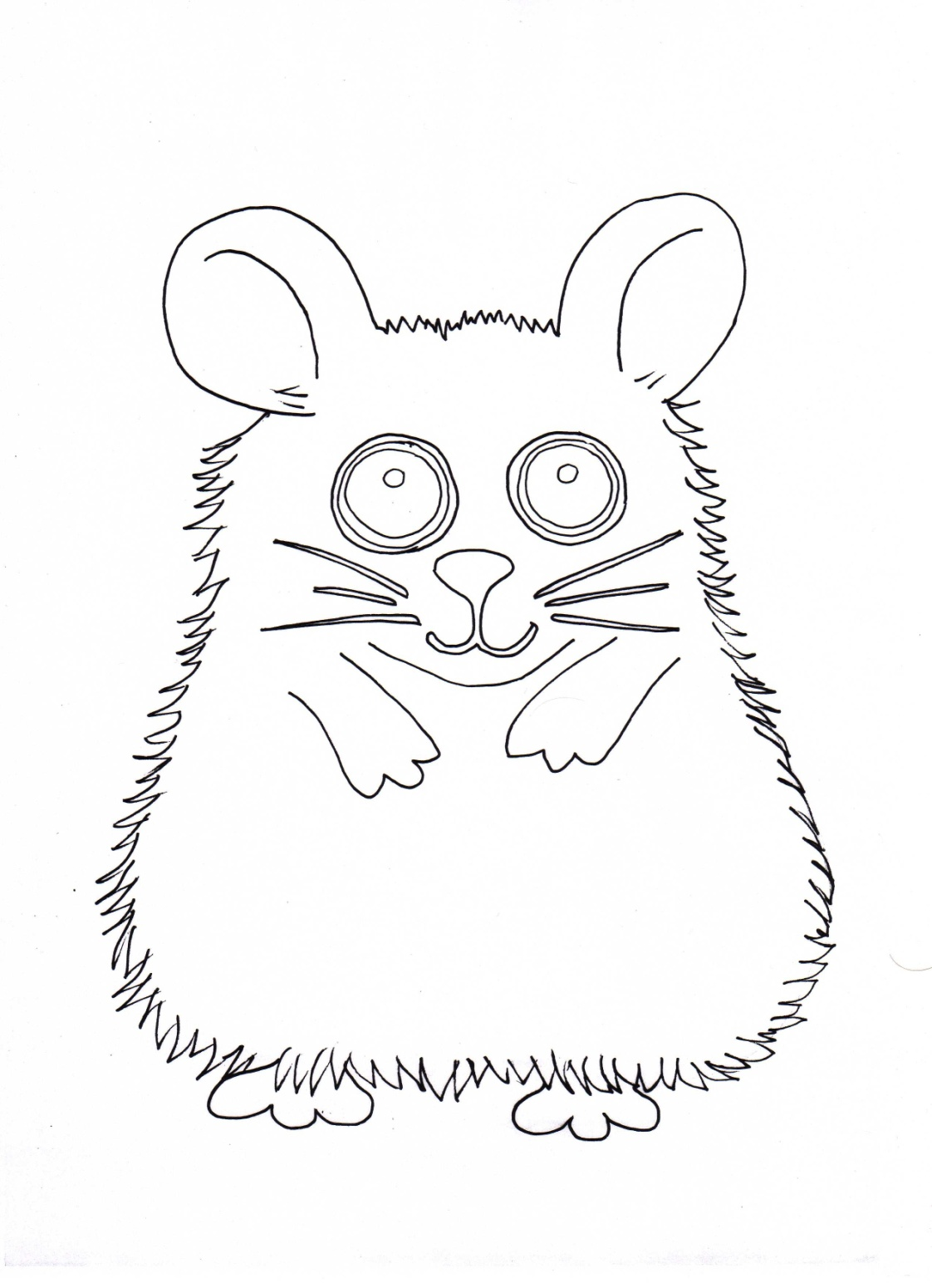
Thank you

Slide 24
Process
Difficult situation
Hard feeling
What could we do in order to feel better?
Do something to feel better
Is it something that I can change?
YES
NÃO
What can I do?
Act towards the PROBLEM
How to feel better?
Act towards ITSELF
Notes:
Frente a uma dificuldade que nos causa desconforto emocional tentamos muitas vezes agir no problema, sem nos apercebermos que também é possível agirmos em nós mesmos, lidando com os sentimentos que aquela dificuldade nos traz. O Programa estimula as crianças a agirem das duas maneiras.

Slide 25
CASEL – Collaborative for Academic, Social and Emotional Learning
317 studies with a total of 324.303 students
Evidence based Social and Emotional Learning Program
Teach Emocitional and Social competencies:
Self awareness
Social awareness
Self management
Relationship skills
Responsible decision making
Less risky behavior , more assets and positive development
Improve accademic performance and school success
Develop safe, caring, cooperative,
well-managed, paticipatory learning environments
Provide opportunities and reward for positive behavior
Greater attachment, engagement and conmitment to school
Notes:
25

